Slide 1
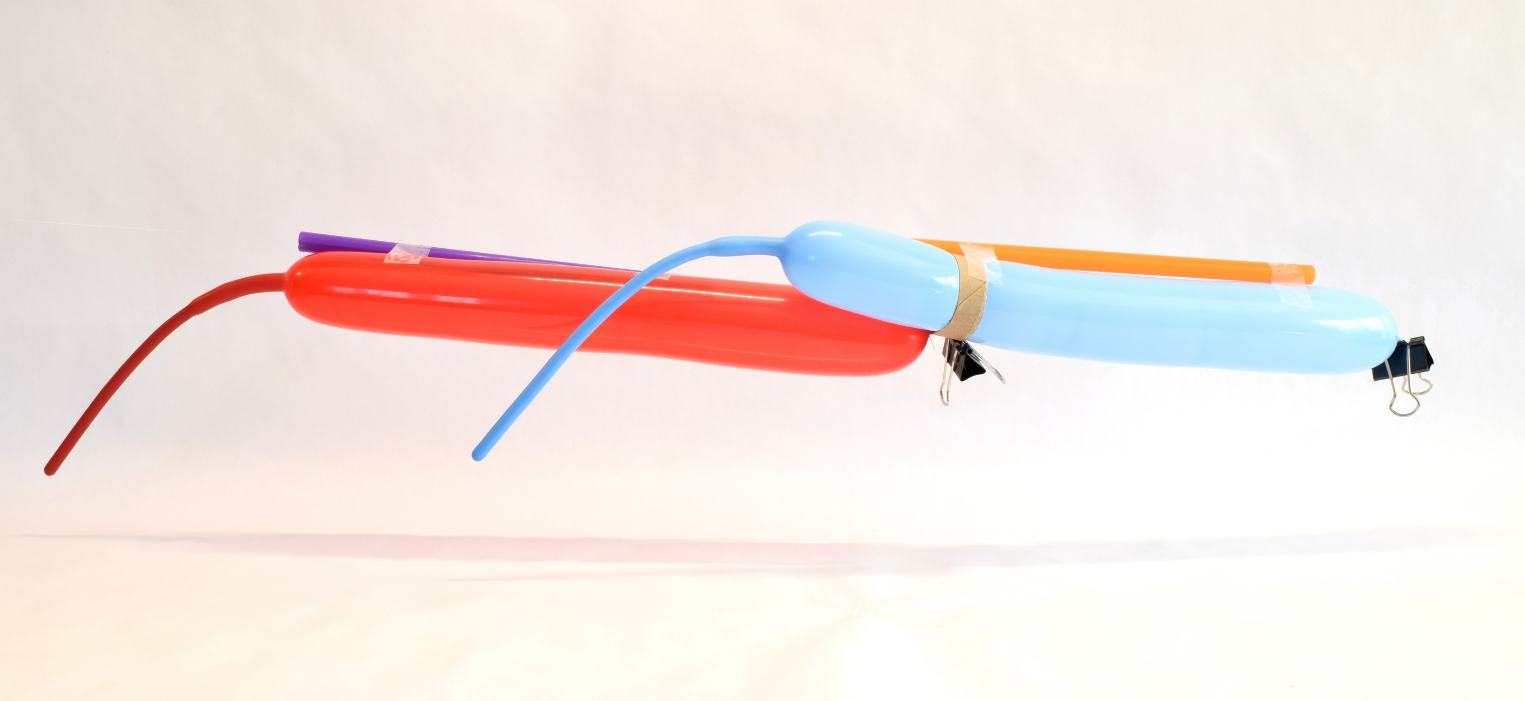

Two-Stage Balloon Rocket
www.sciencebuddies.org

Slide 2
Balloon Rockets
Newton’s third law: for every action, there is an equal and opposite reaction
Straw
Tape
String
Air is pushed out the back of the balloon
The balloon is pushed forward

Slide 3
Real life two-stage rockets
First stage lifts rocket through beginning of flight
First stage breaks away and falls back to Earth
Second stage continues flight into space
Saves energy because second stage doesn’t have to carry extra weight of depleted first stage
2nd stage fires
1st stage falls back to Earth
1st stage fires

Slide 4
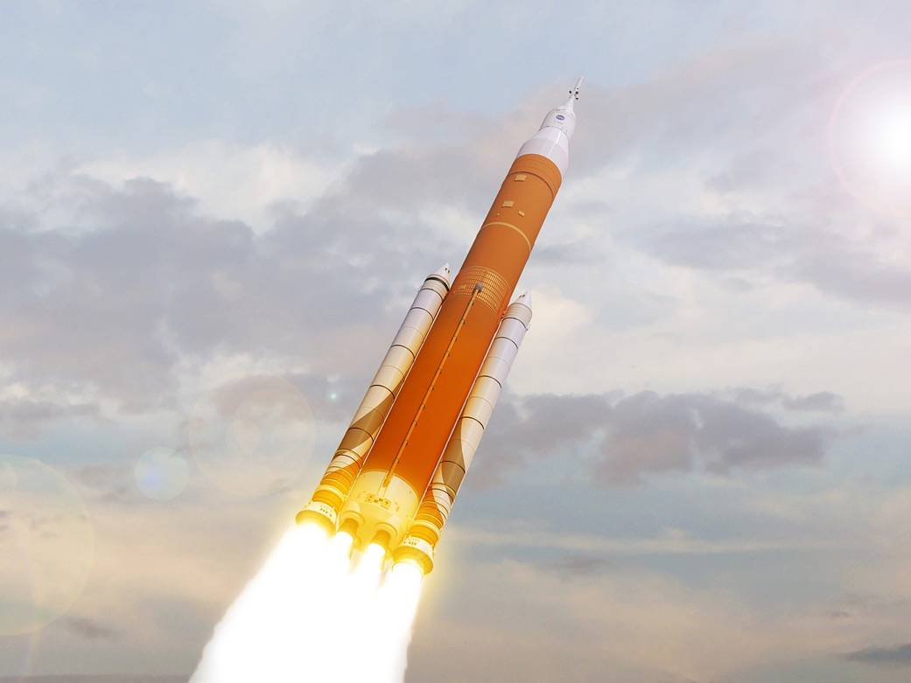
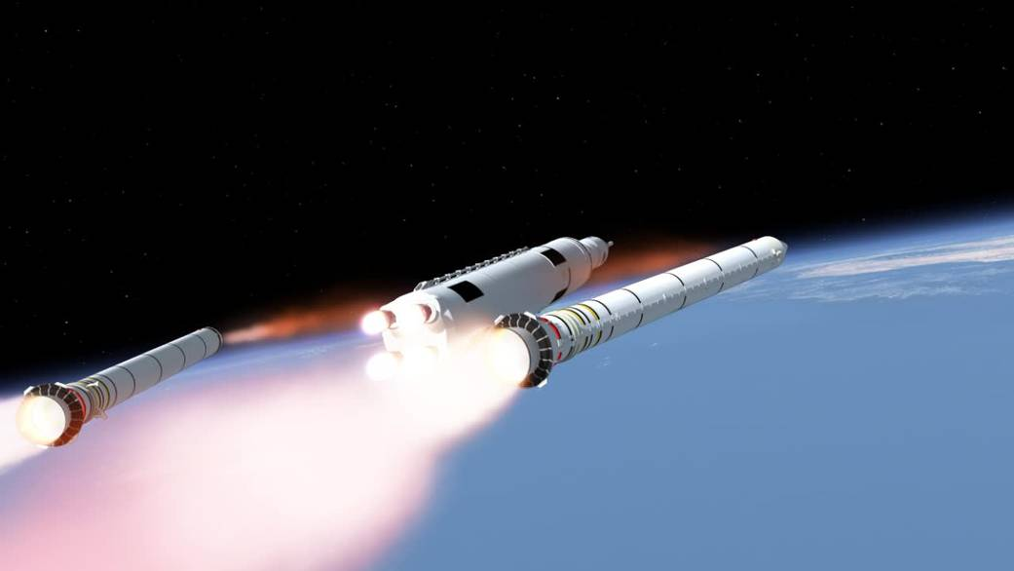
Example: NASA’s Space Launch System (SLS)
First stage:
Booster separation:
Image credits: NASA

Slide 5
How could you build a two-stage balloon rocket?

Slide 6
How could you build a two-stage balloon rocket?
Ring cut from paper towel tube
1st stage
2nd stage
Binder clip pinches nozzle of first stage shut
First stage squeezes nozzle of second stage shut against cardboard ring

Slide 7
How does it work?
Remove the binder clip – air escapes from the first stage and pushes both balloons
Second stage stays pinched shut at first

Slide 8
How does it work?
First stage deflates
Nozzle of second stage is no longer pinched shut, air starts to escape

Slide 9
How does it work?
First stage gets left behind
Second stage continues moving

Slide 10
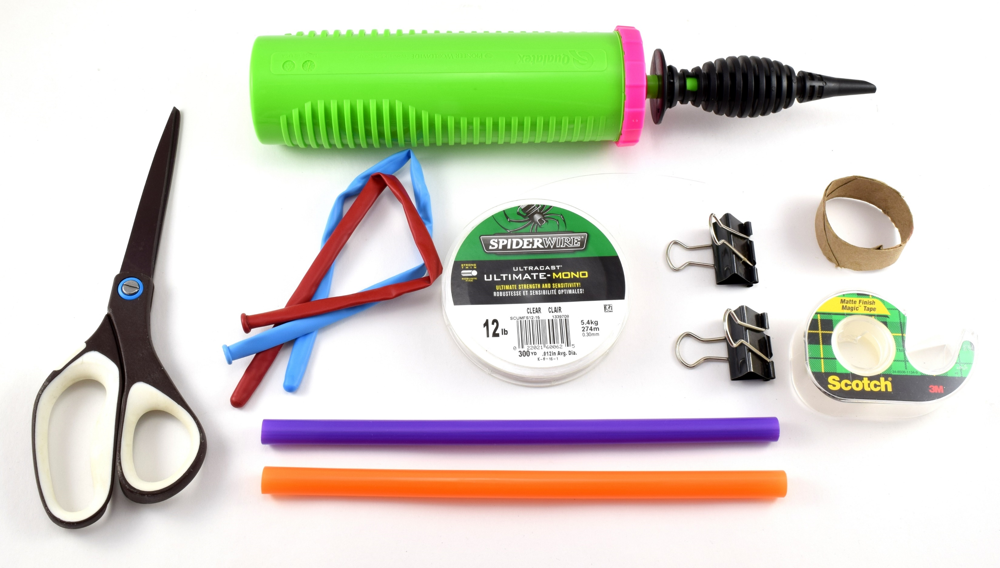
Materials

Slide 11
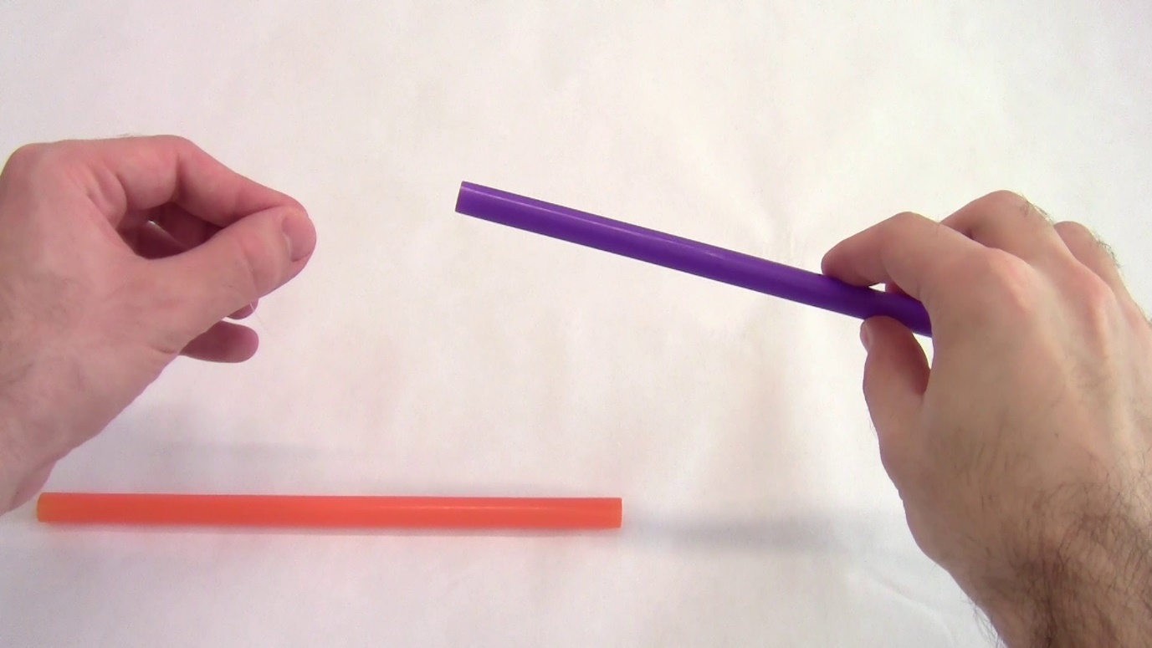
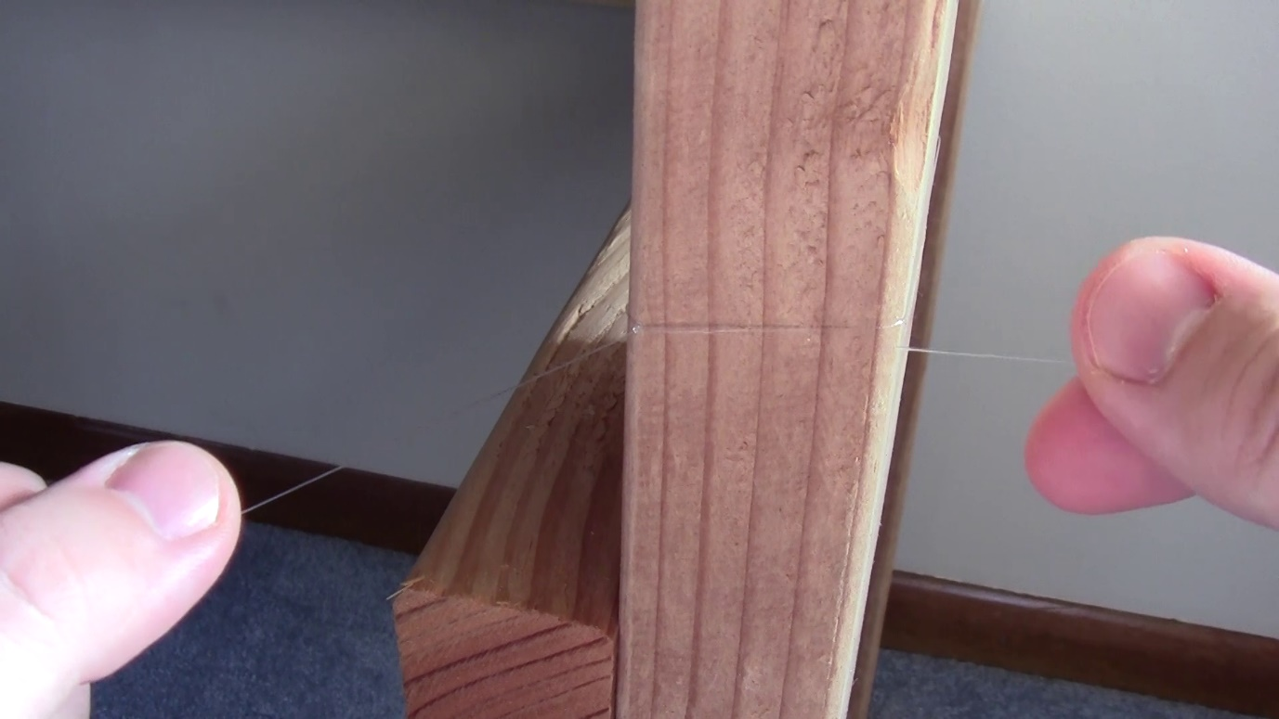
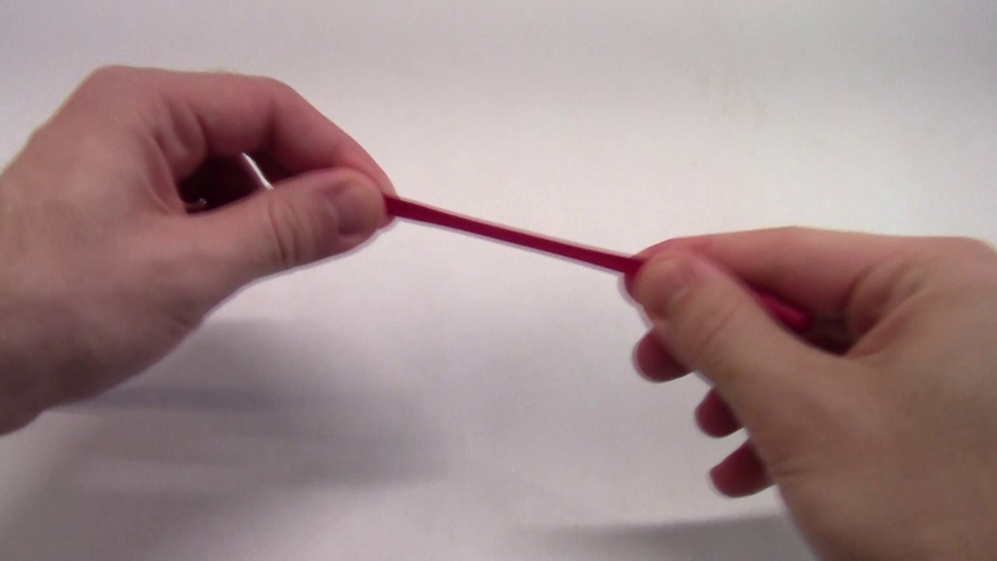
Setup
Thread fishing line through two straws
Tie fishing line tightly across classroom
Cut a small section (less than 1 inch) from the paper towel tube
Stretch balloons to loosen them before inflating

Slide 12
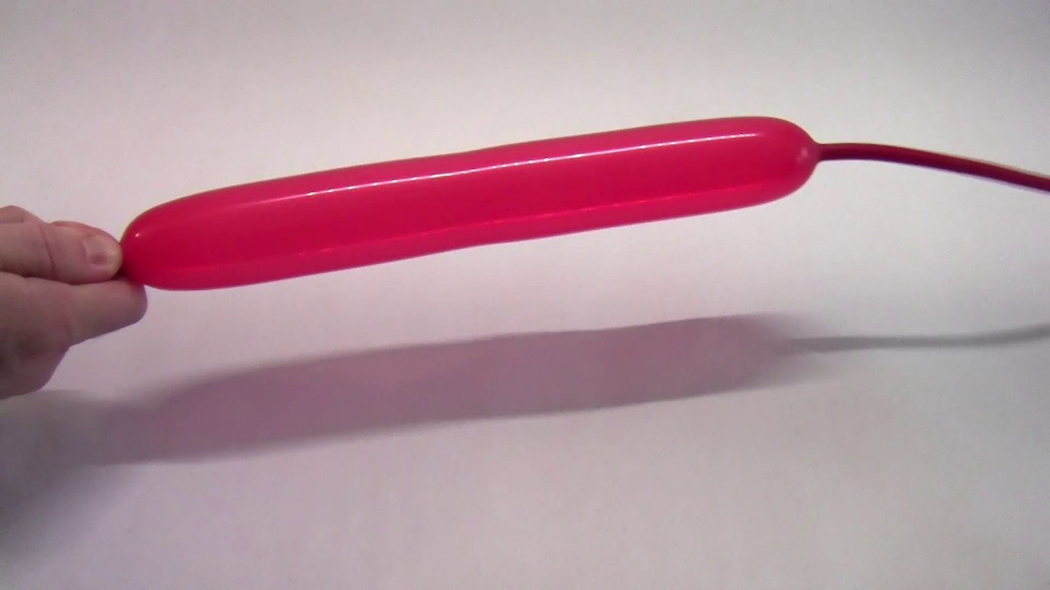
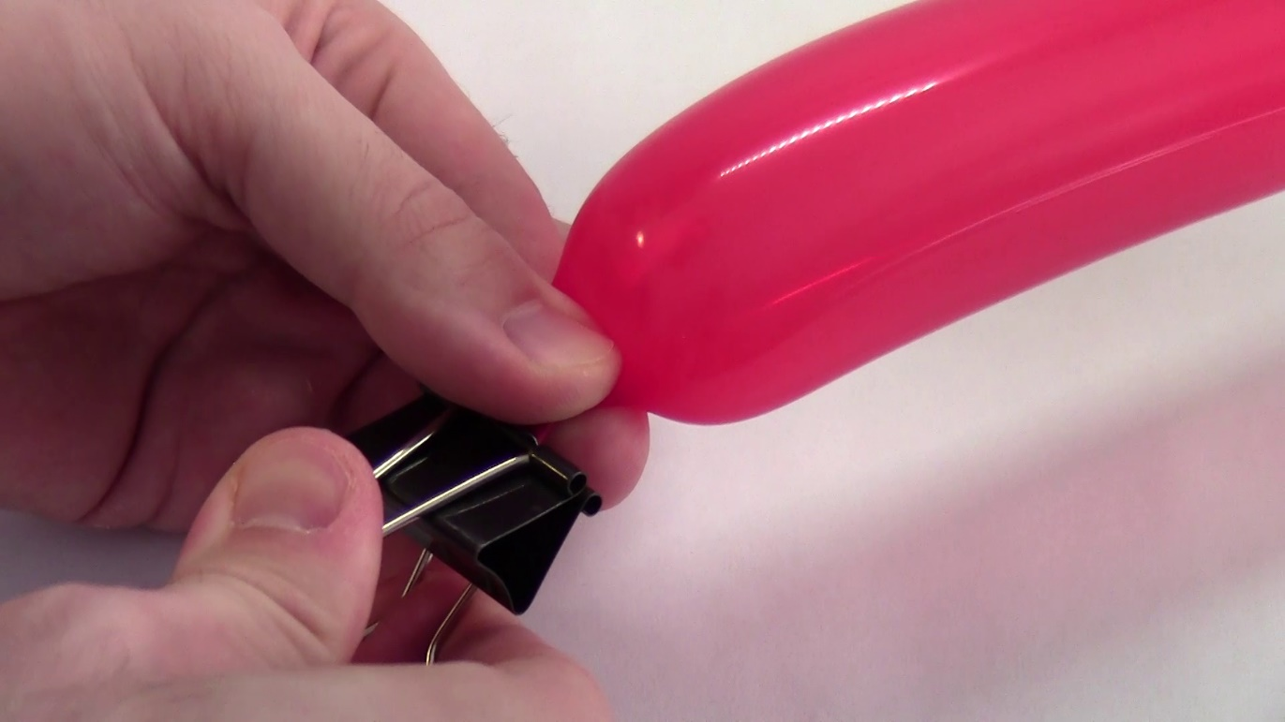
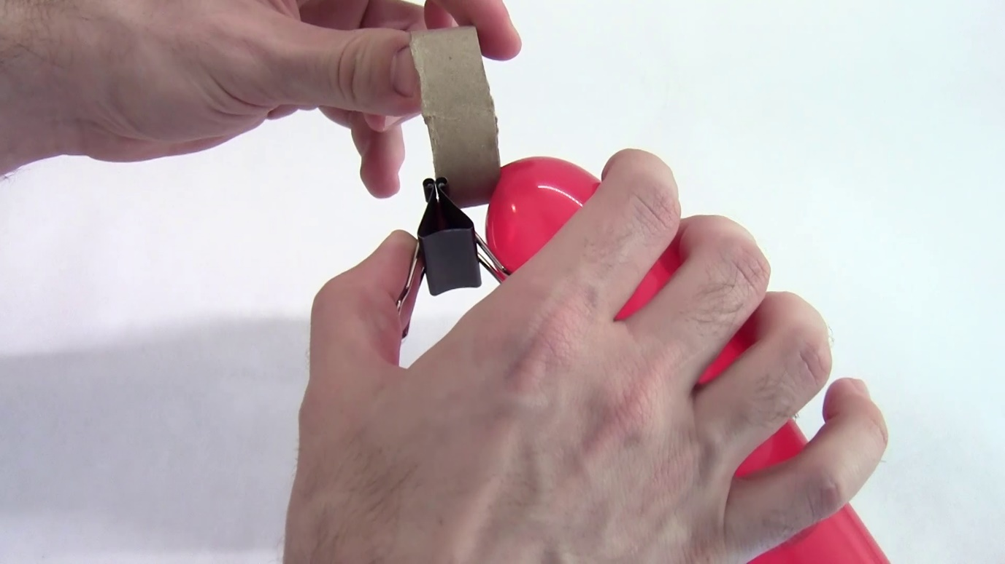
Build your rocket
Inflate first balloon at least halfway (don’t inflate it so much that it starts to curve)
Pinch its nozzle shut with binder clip
Thread nozzle through cardboard ring

Slide 13
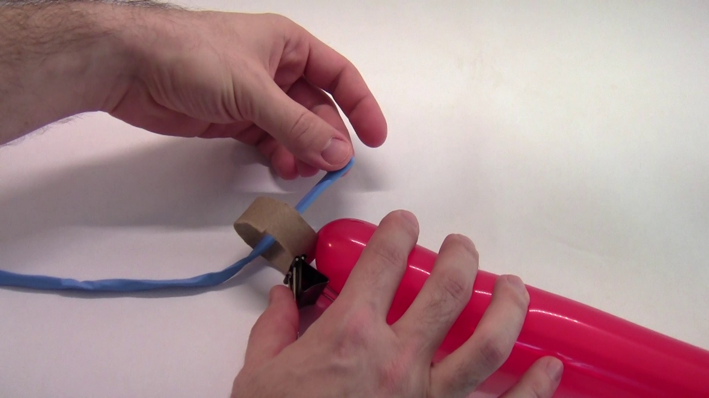
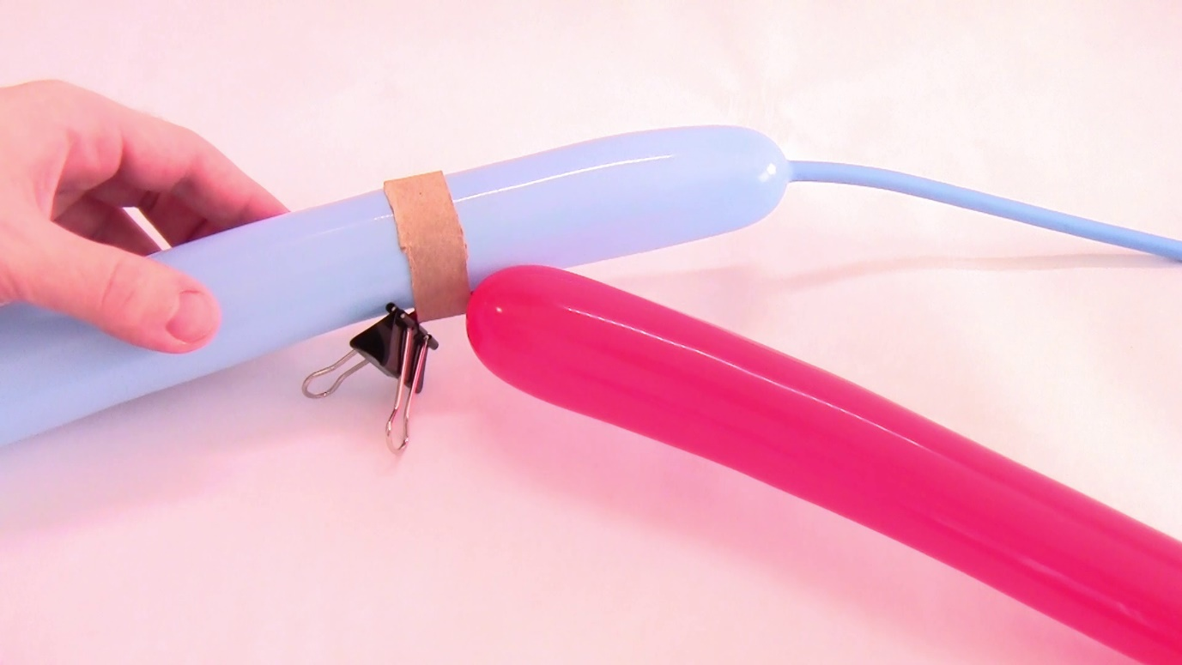
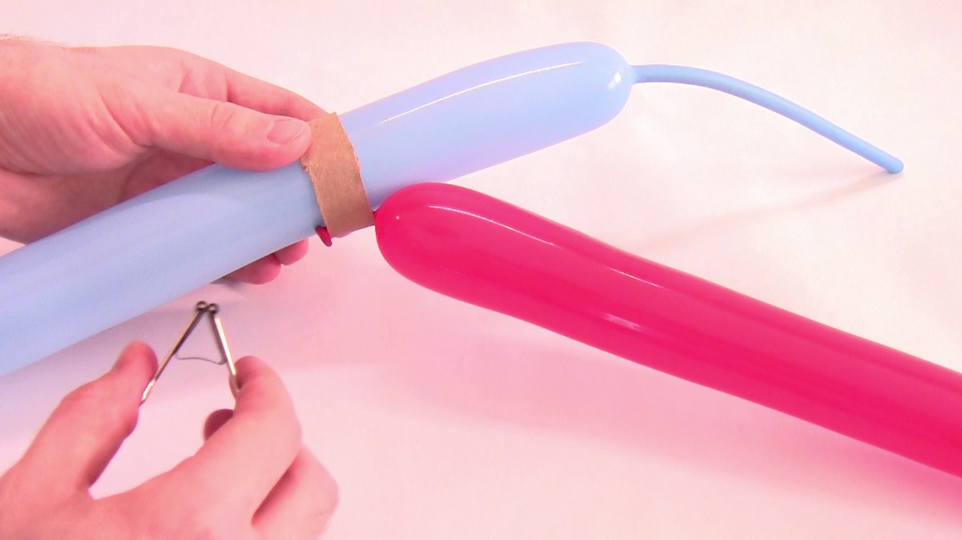
Build your rocket
Thread second balloon partially through cardboard ring
Inflate second balloon so it pinches nozzle of first balloon shut
You should be able to remove the binder clip without the balloon deflating
Be patient – this can be difficult! Try twisting the first balloon a few times, this may help
Much easier with two people
Use another binder clip to pinch the nozzle of the second balloon shut

Slide 14

Attach to fishing line
Tape the balloons to the straws
Try to keep the balloons and straws pointed in a straight line
Don’t tape the balloons to each other – this will prevent the stages from separating!
Might need to experiment with exactly where you put the tape (you can also tape the cardboard ring to a straw)
Note: the first balloon you inflated becomes the second stage of your rocket, and vice versa

Slide 15
Launch!
Pull both balloons to one end of the fishing line
Get ready to release the nozzle of the first stage – what do you think will happen?
Snapshots from slow-motion video

Slide 16
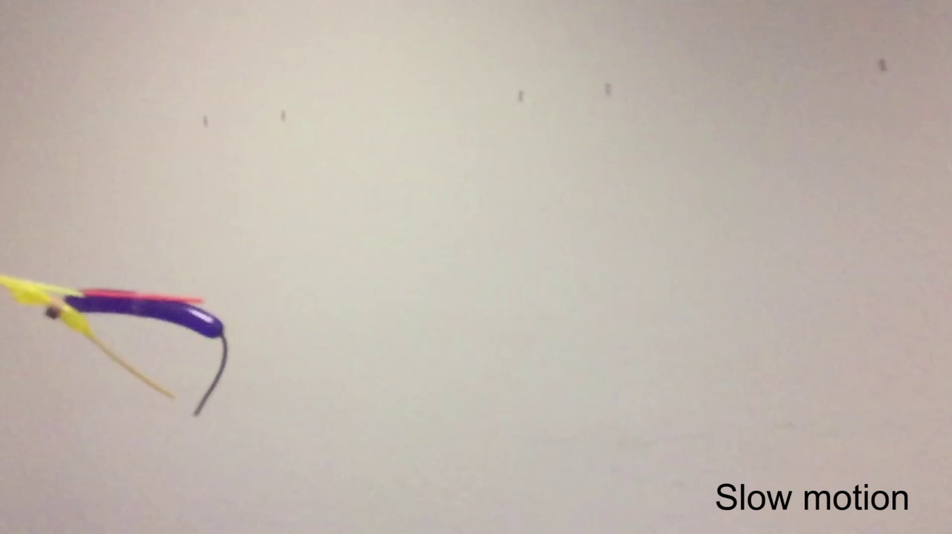
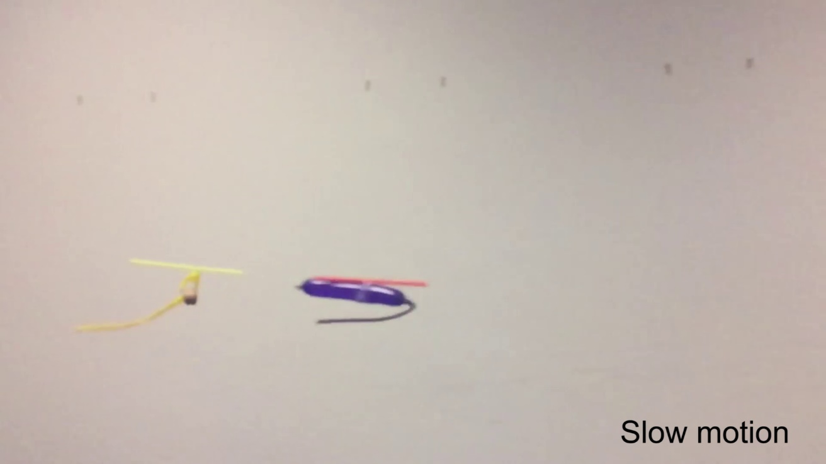
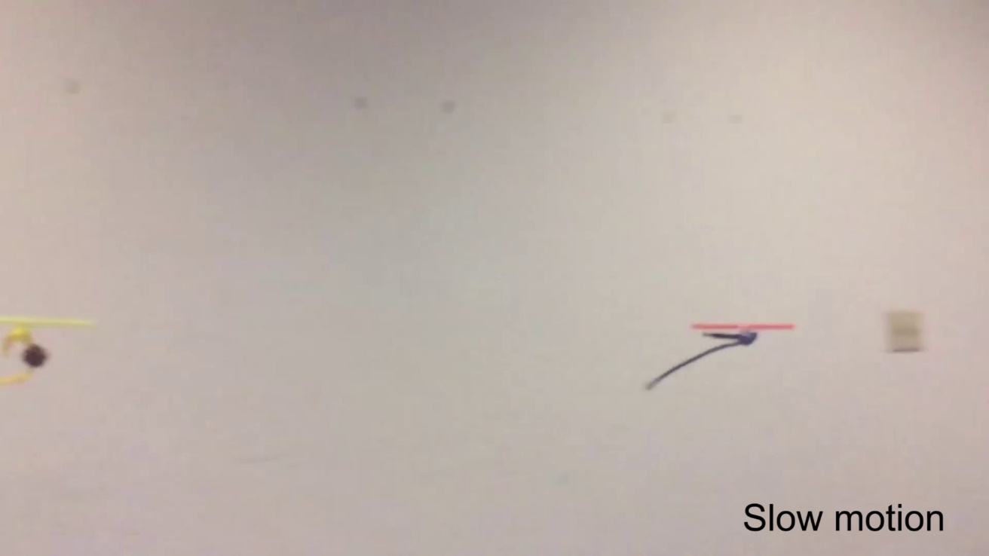
Launch!
Pull both balloons to one end of the fishing line
Get ready to release the nozzle of the first stage – what do you think will happen?
Your balloons should rocket along the string:
  The first stage deflates, pushing both balloons
  The second stage starts to deflate when its nozzle is no longer pinched shut
  The second stage continues moving without the first stage
Snapshots from slow-motion video

Slide 17
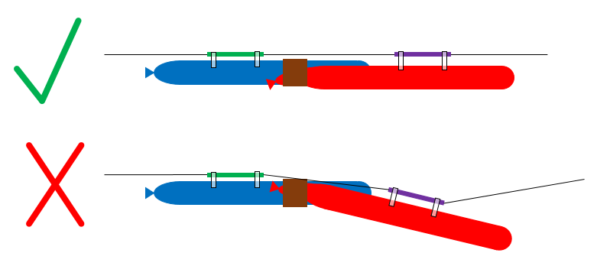
Troubleshooting
Don’t get frustrated if your rocket doesn’t work on the first try! Here are some things to watch out for:
The second stage might deflate early if its nozzle isn’t initially pinched shut all the way. Leave the binder clip in place until the last second if necessary.
If the balloons and straws are not in a straight line, this can cause extra friction along the fishing line and slow your rocket down.

