Slide 1
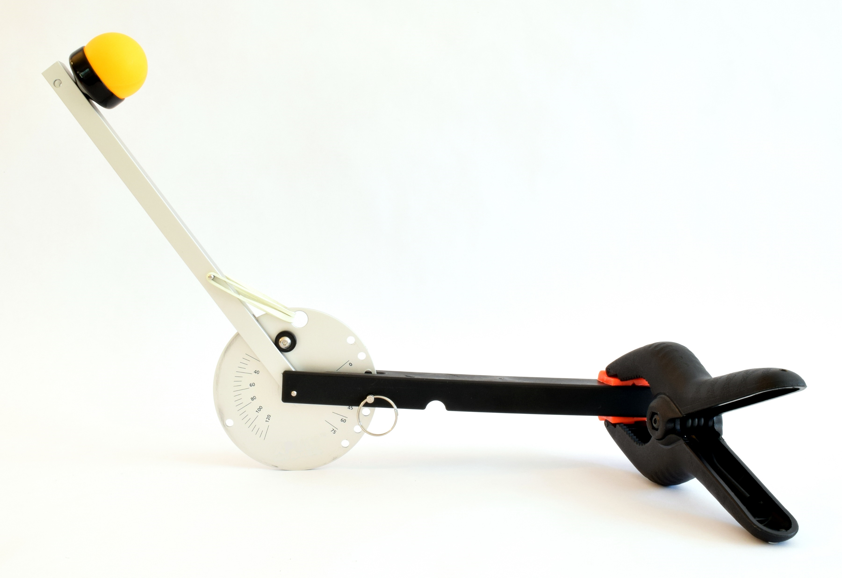

Ping Pong Catapult
www.sciencebuddies.org

Slide 2
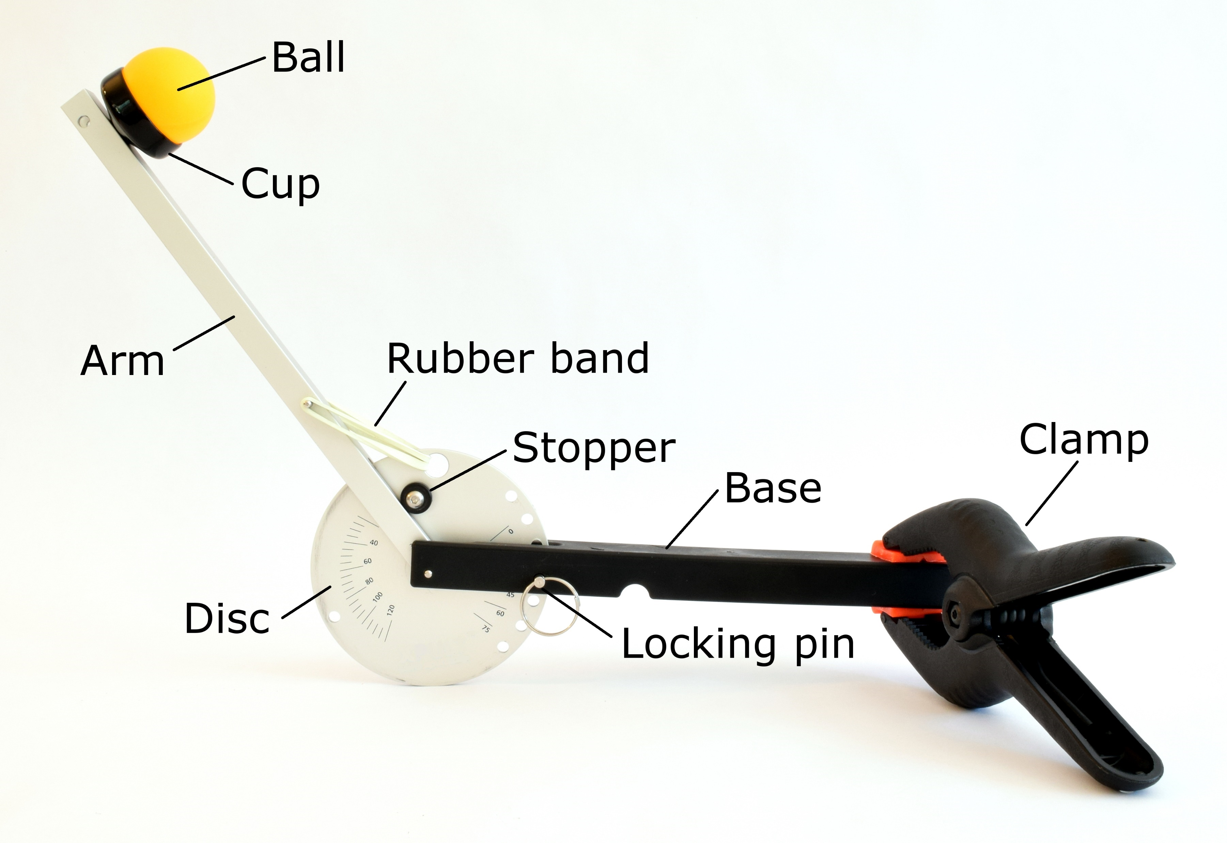
Parts of the catapult

Slide 3
You can change the launch angle and the pull-back angle
Launch Angle
Pull-back Angle

Slide 4
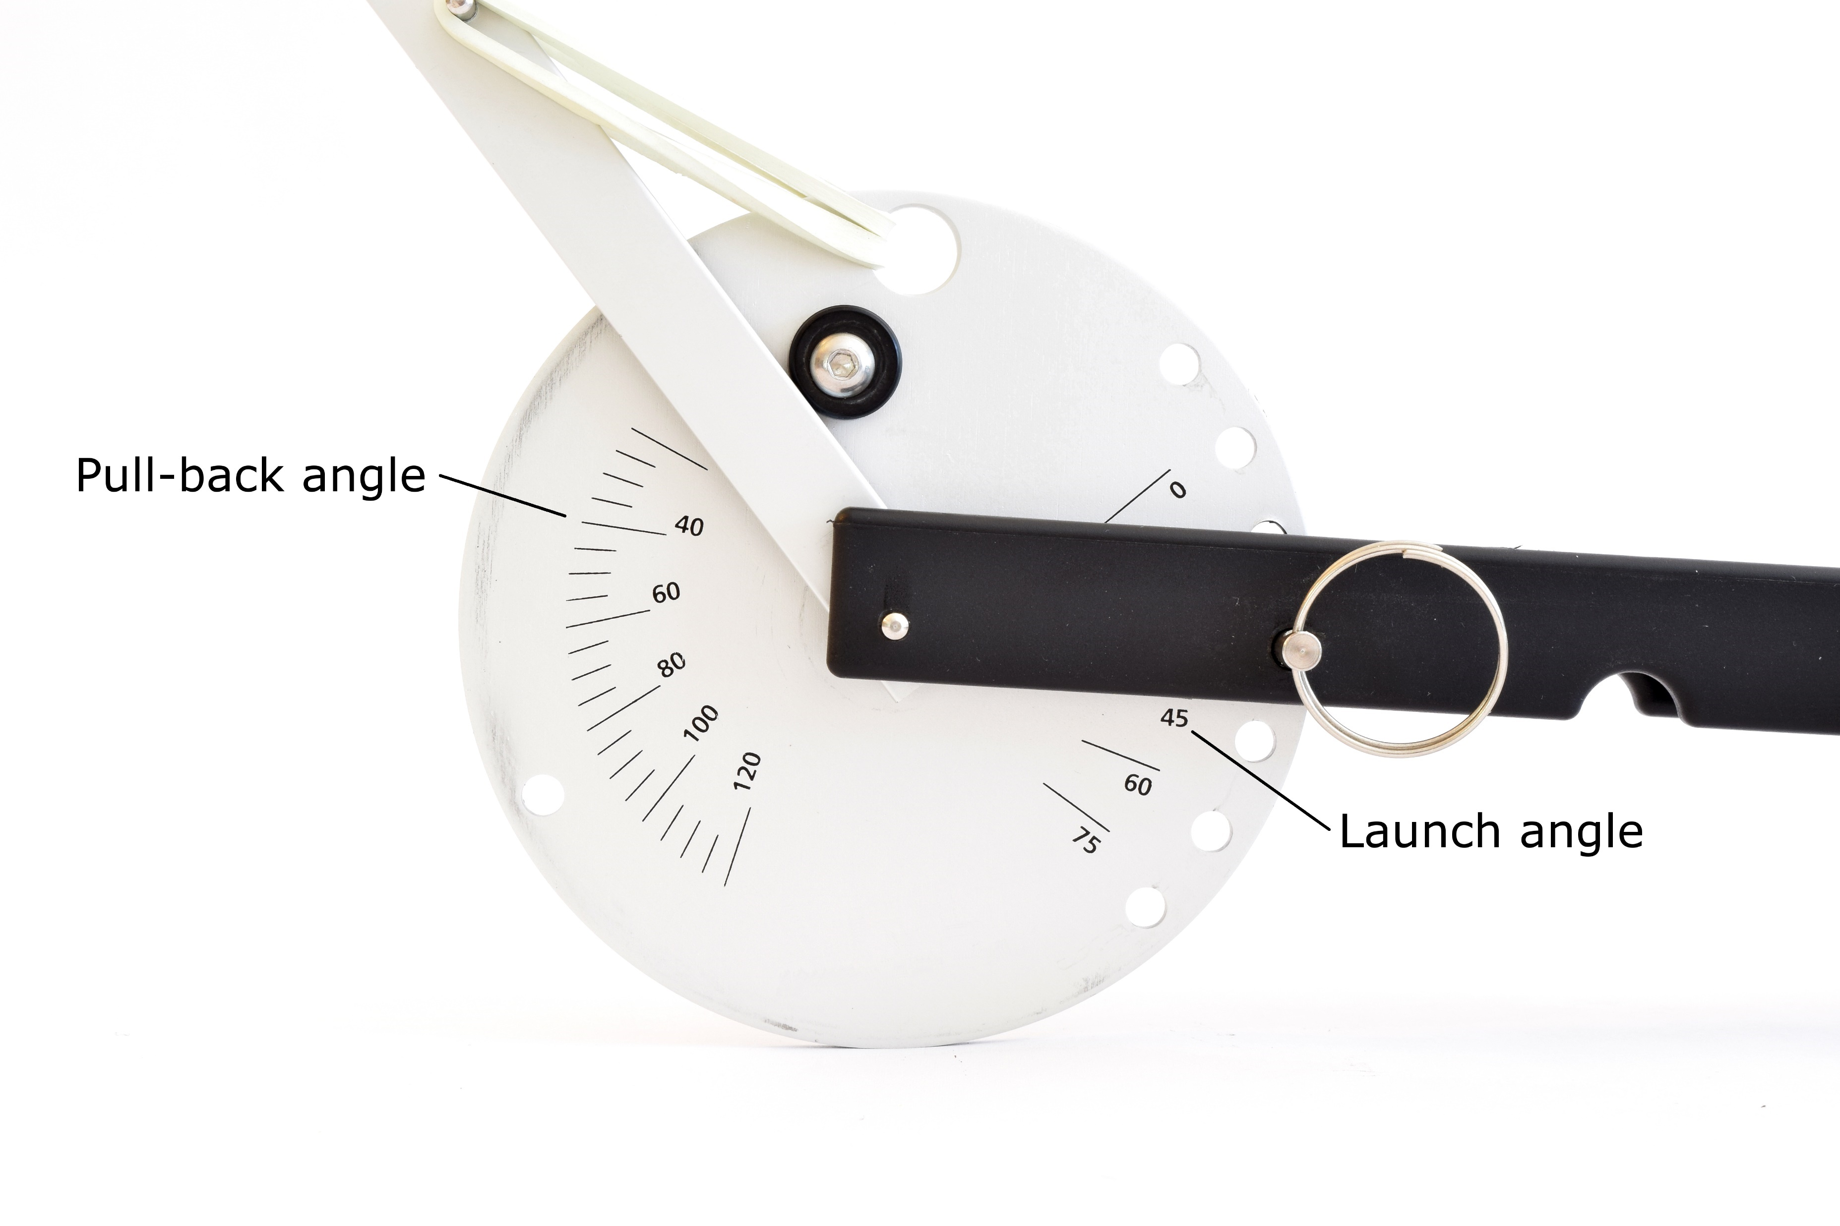
Markings on the catapult let you measure both angles

Slide 5
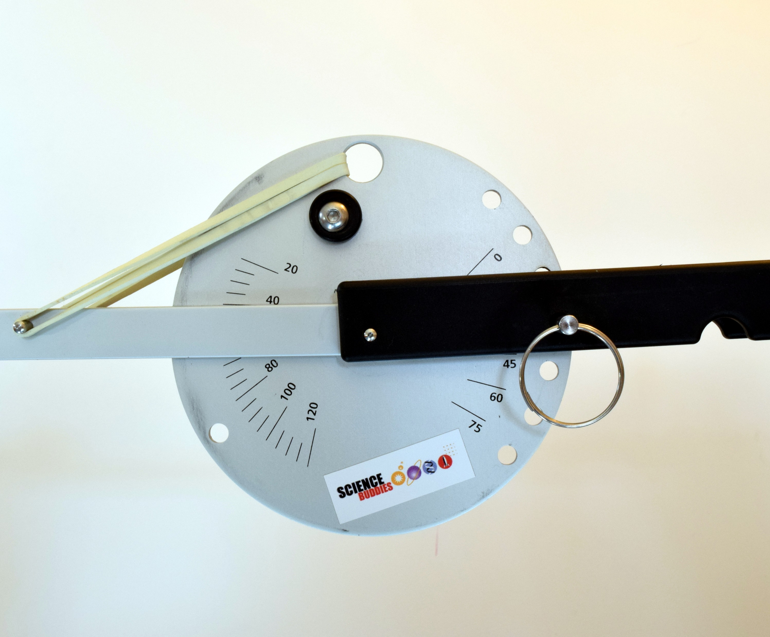
Example
The pullback angle is 40 degrees (read from the top edge of the arm)
The launch angle is 45 degrees (read from the bottom edge of the base)

Slide 6
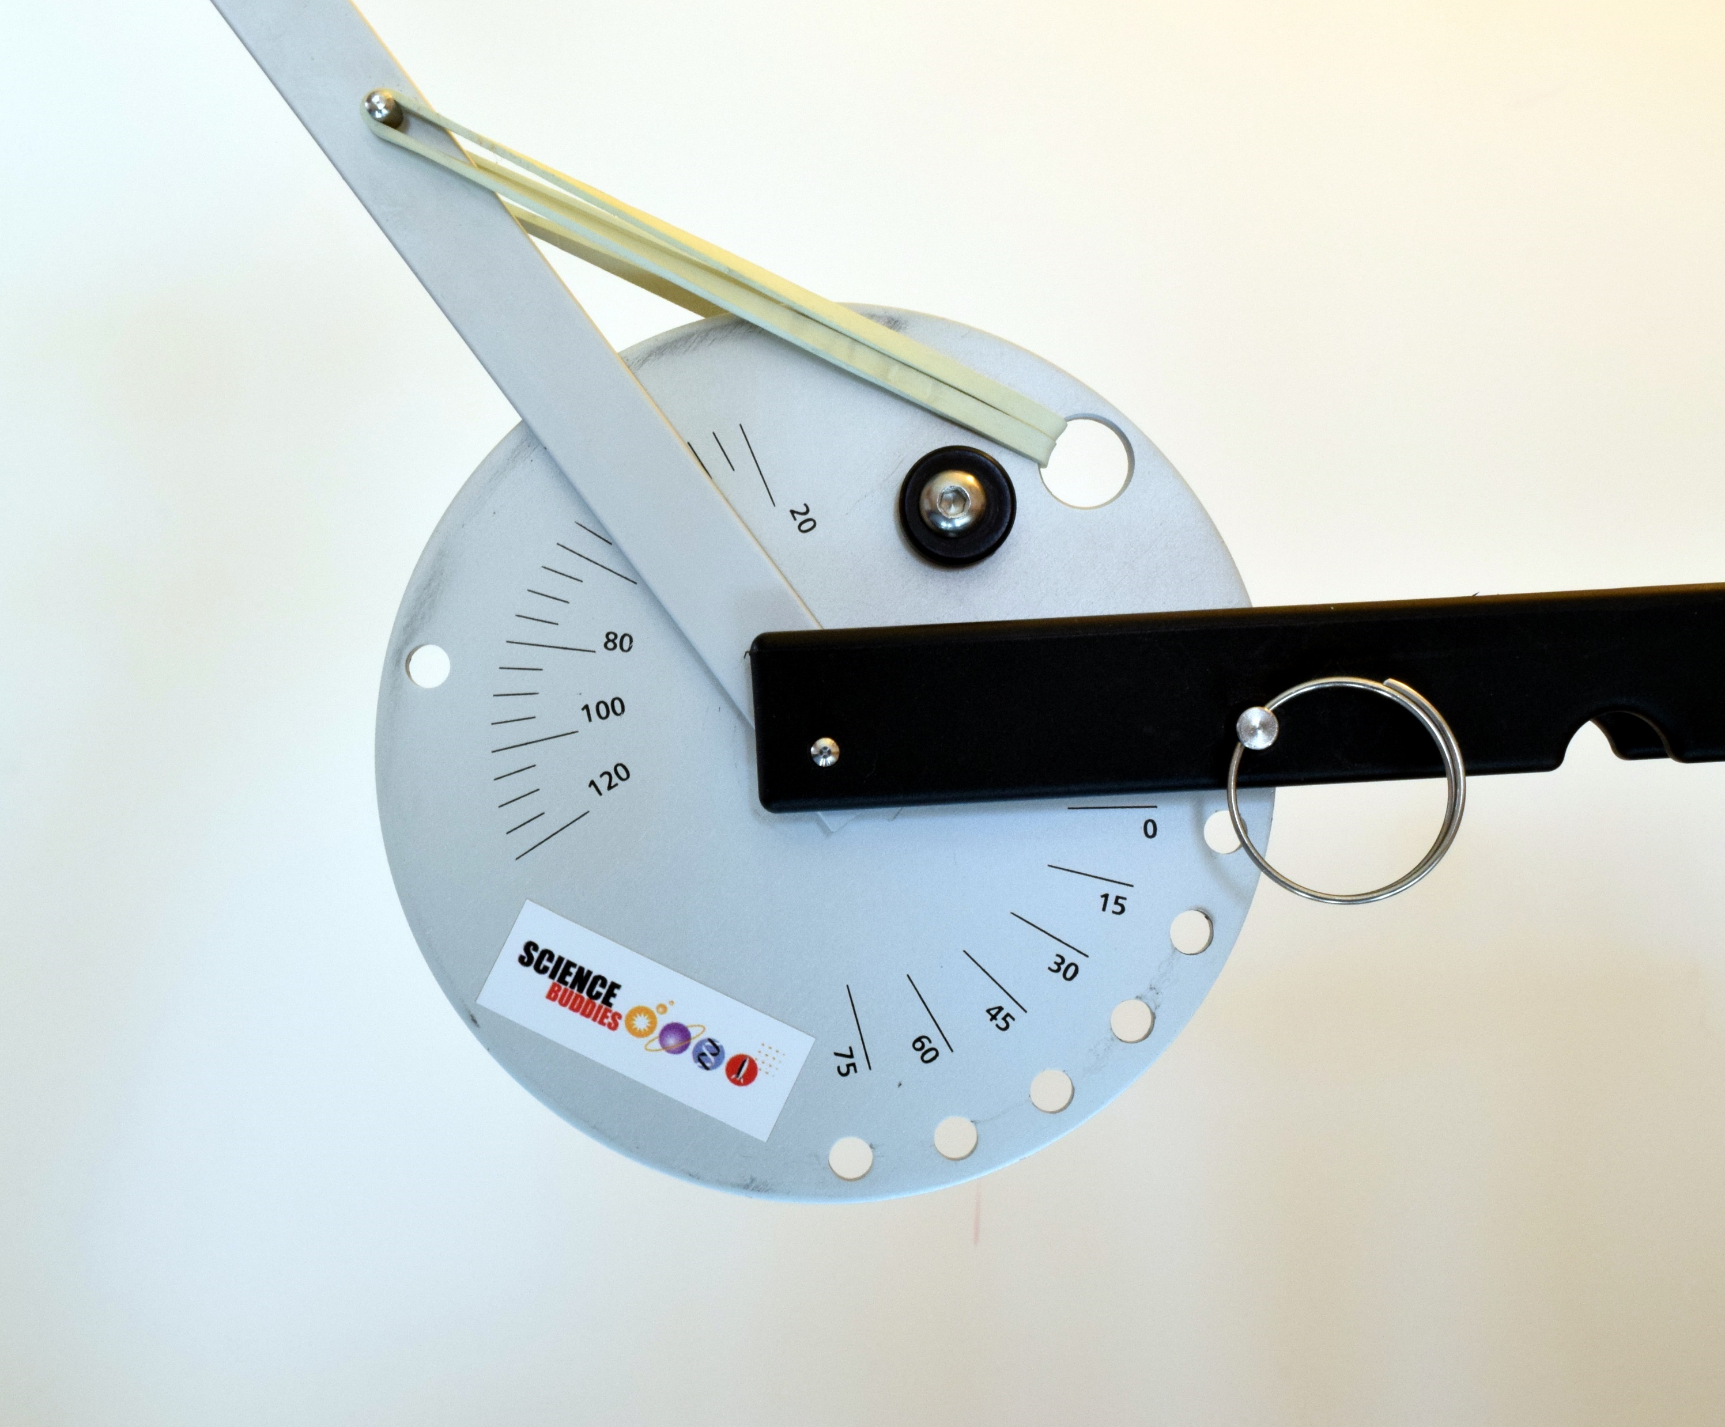
Example
The pullback angle is 30 degrees (the marks are in 5-degree increments)
The launch angle is 0 degrees (there may be some wobble in the locking pin, so the mark does not line up perfectly. This is OK.)

Slide 7
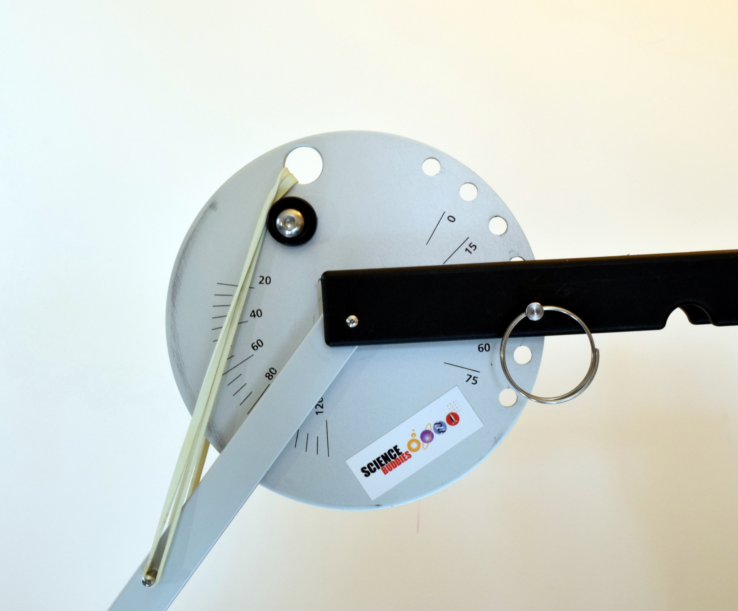
Practice
What are the launch and pull-back angles in this picture?
Notes:
Answers: Pull-back angle = 80 Launch angle = 60

Slide 8
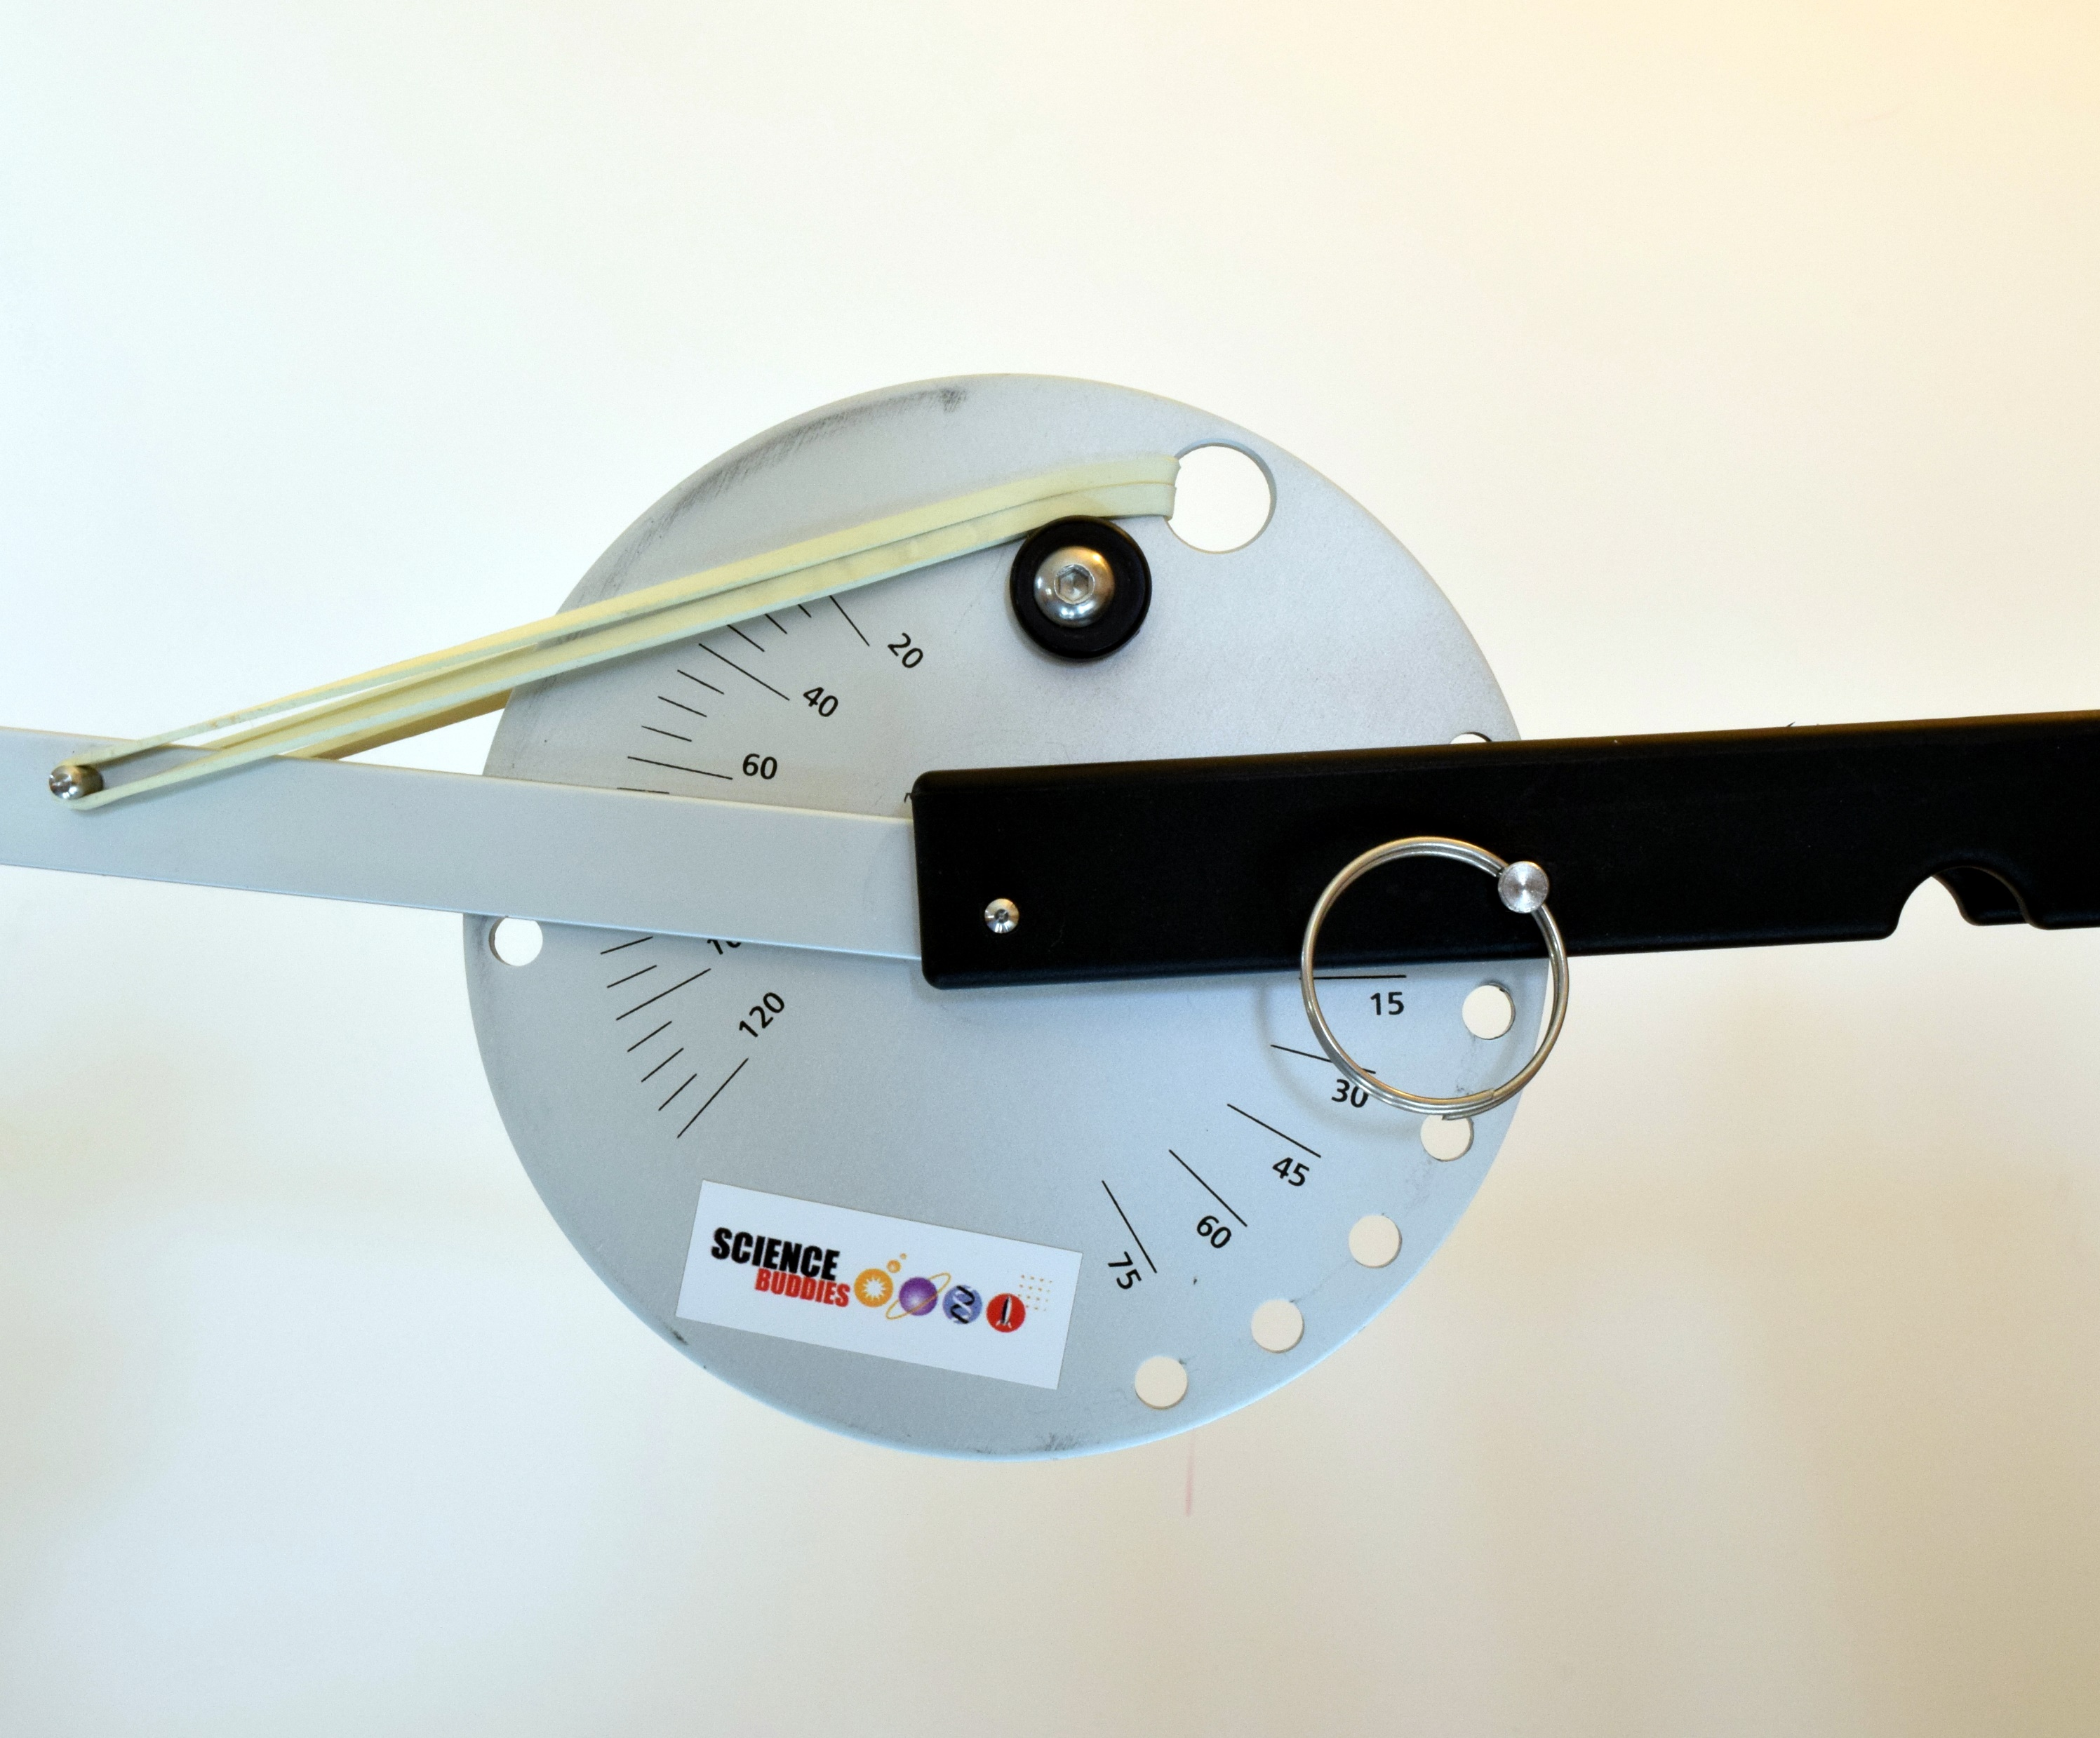
Practice
What are the launch and pull-back angles in this picture?
Notes:
Answers: Pull-back angle = 65 Launch angle = 15

