Slide 1
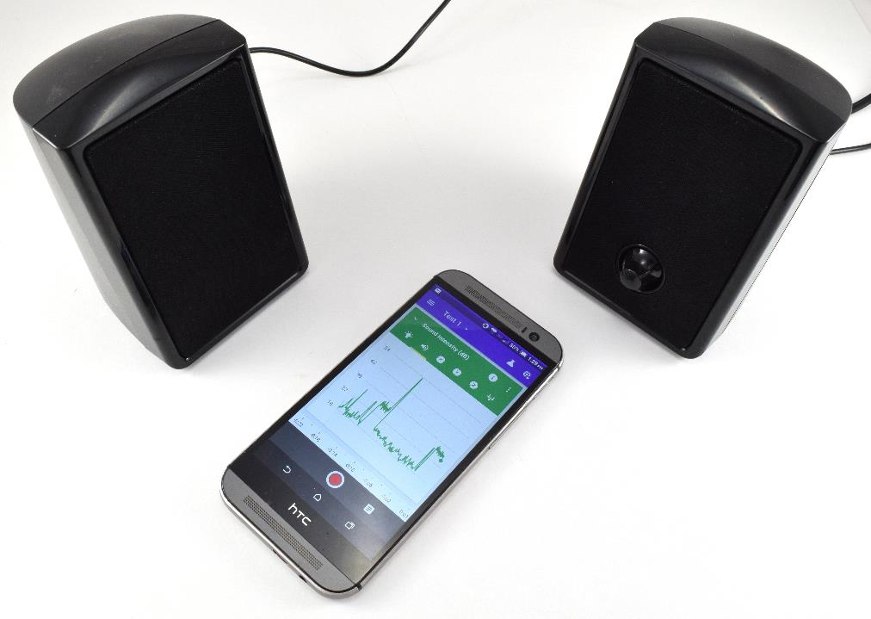

Block That Noise!
www.sciencebuddies.org

Slide 2
Sound waves
Reflected
Absorbed
Transmitted

Slide 3
Sound levels are measured in decibels (abbreviated dB)

Slide 5
Immediate hearing damage
Long-term exposure causes hearing damage

Slide 6
Decibels are a non-linear scale.
What does that mean?

Slide 7
A change of +10dB means the sound is twice as loud.

Slide 8
Sound confusing? Don’t worry, let’s look at the graph again.

Slide 9
City traffic: 70dB
Normal conversation: 60dB
City traffic is twice as loud as a normal conversation!

Slide 10
Chainsaw: 100dB
Moderate rainfall: 50dB
A chainsaw is not twice as loud as moderate rainfall, it is 32x as loud!

Slide 11
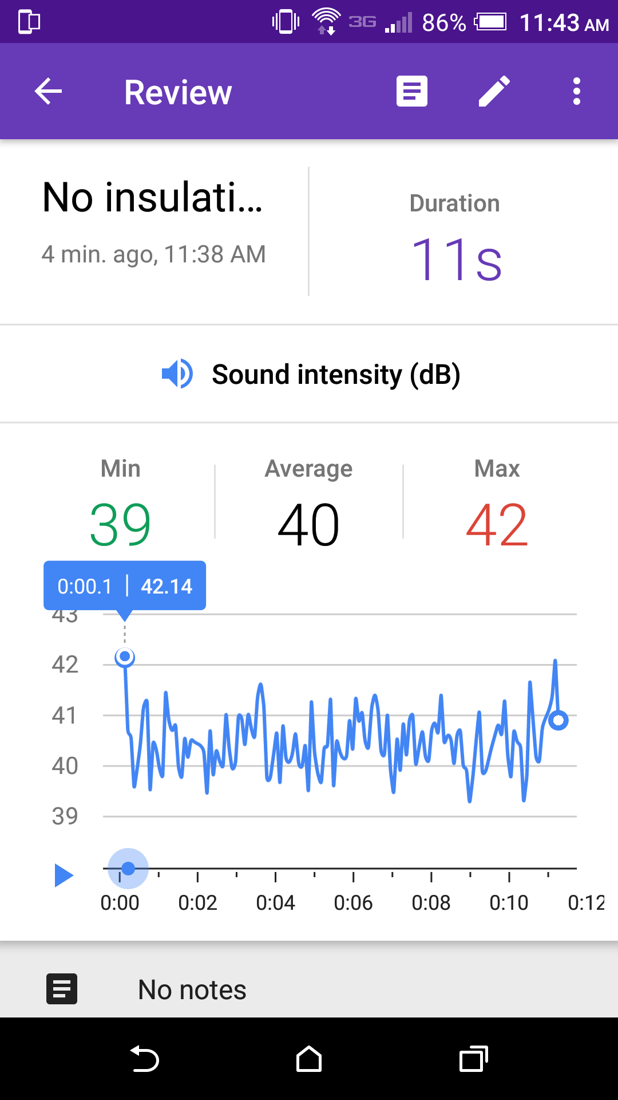
Google Science Journal
App that can measure sound levels in decibels using your phone’s microphone

Slide 12

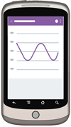
Your Challenge
Design and build a sound-insulating container
Try to get the decibel value as low as possible
Speakers
Phone with Google Science Journal
Sound-insulating container

