Slide 1
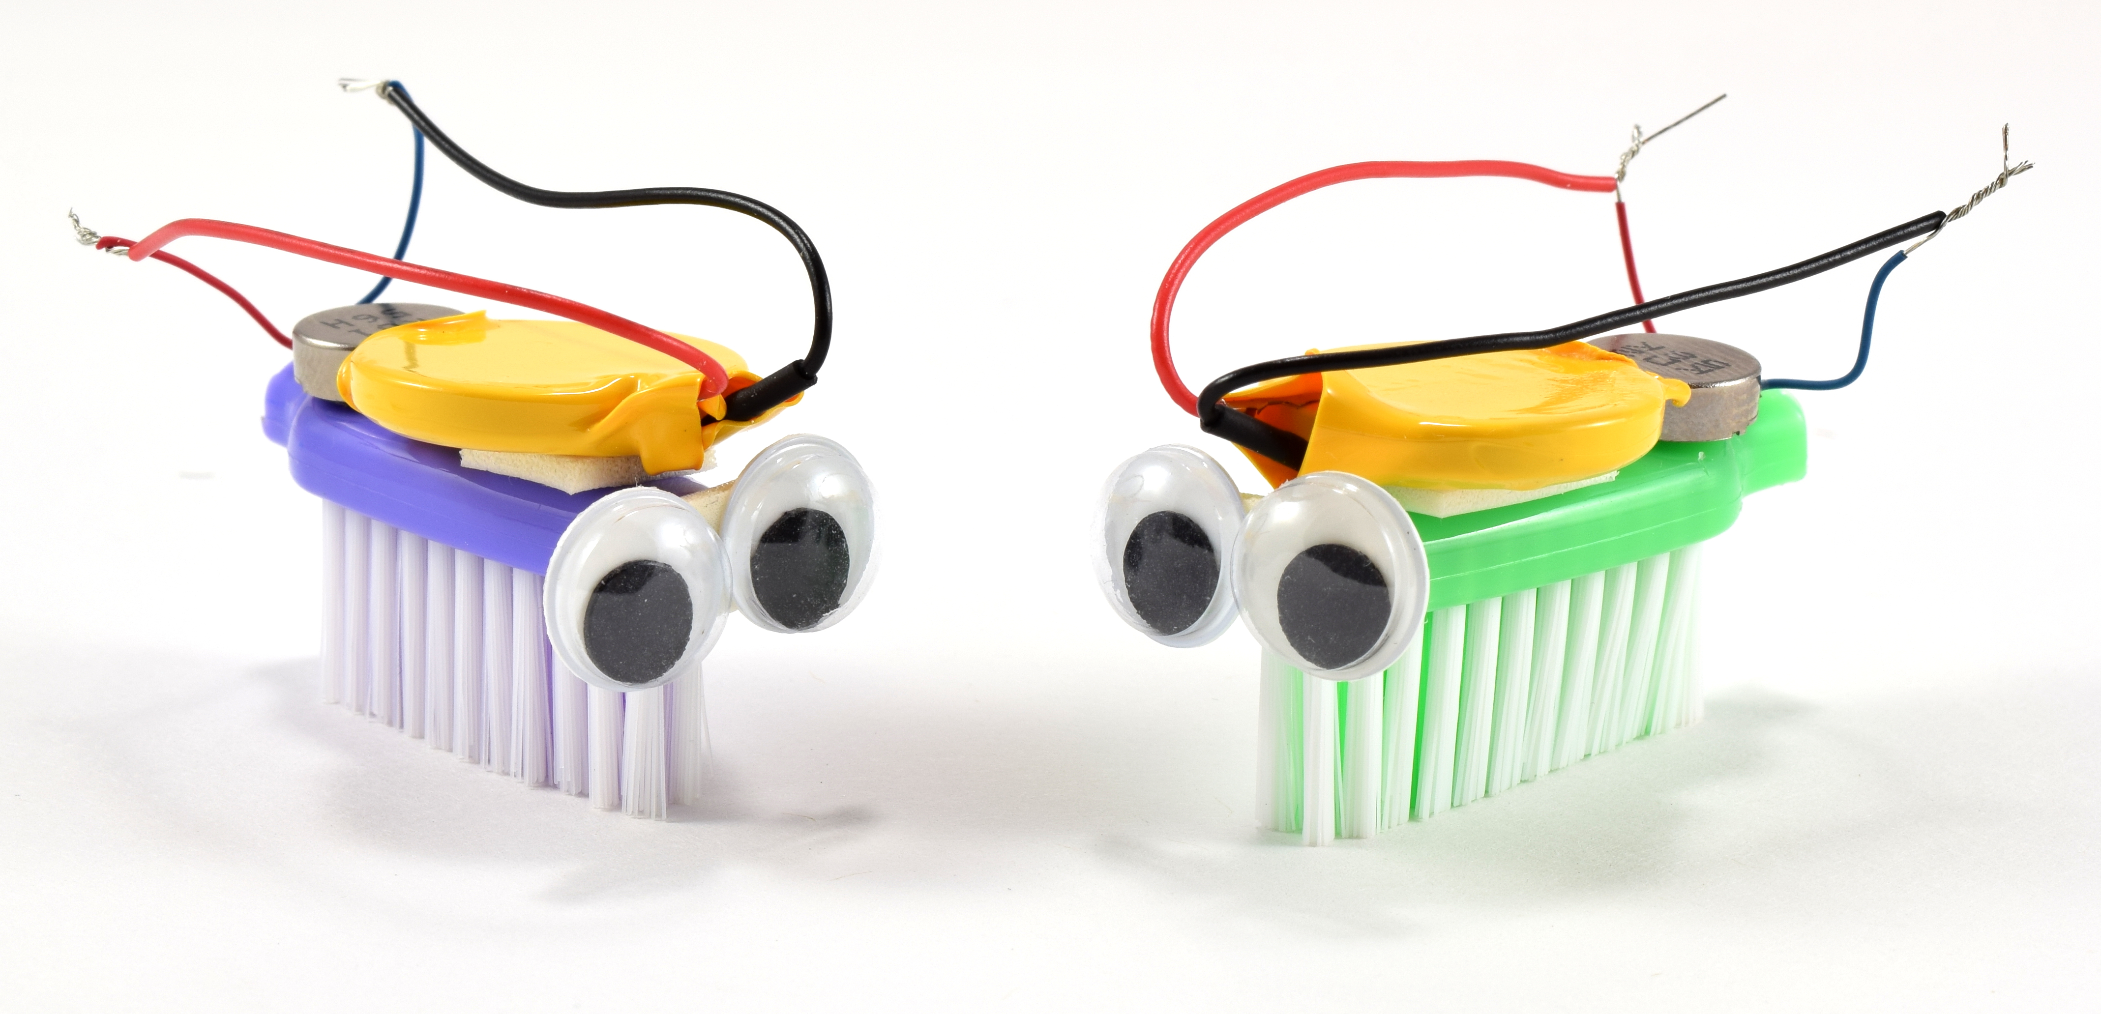

Bristlebots
www.sciencebuddies.org

Slide 2
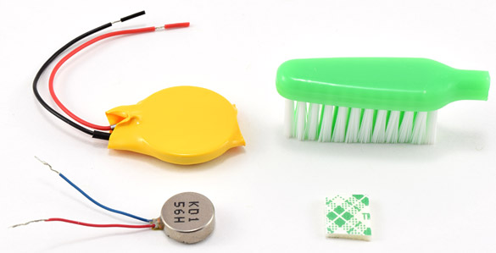
You will need:
Coin cell battery
Vibration motor
Toothbrush head
Double-sided foam tape

Slide 3
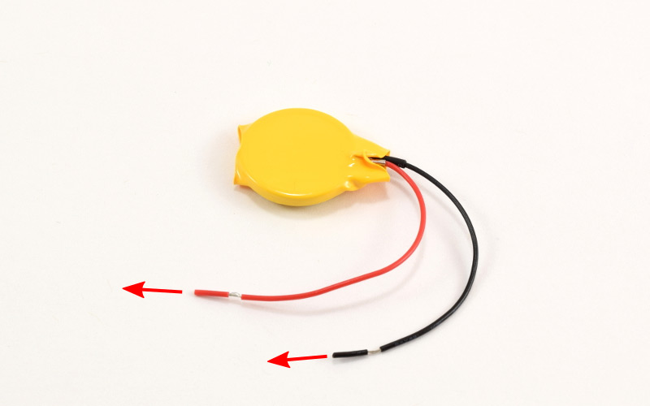
Pull small pieces of insulation off battery wires

Slide 4
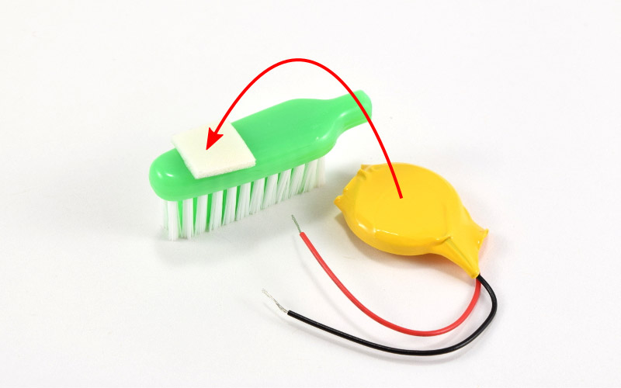
Attach battery to toothbrush head with double-sided foam tape

Slide 5
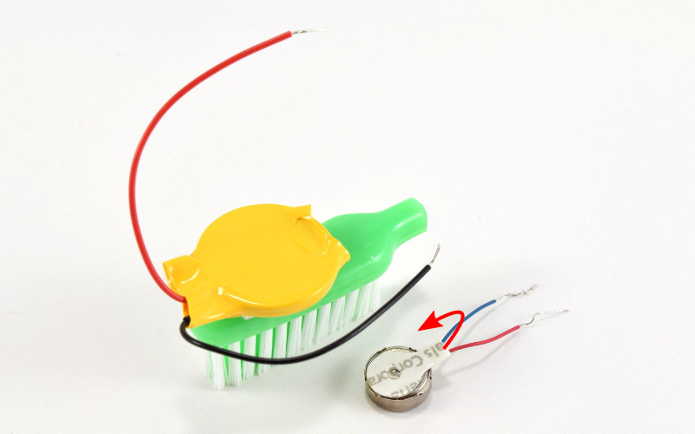
Peel paper backing off motor

Slide 6
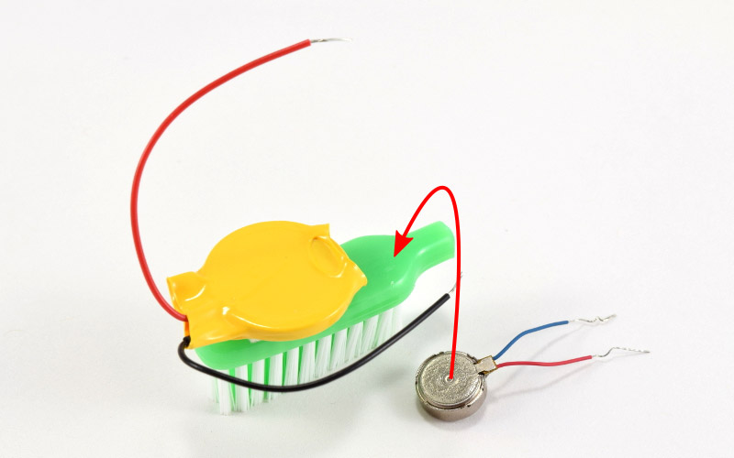
Stick motor to toothbrush head

Slide 7
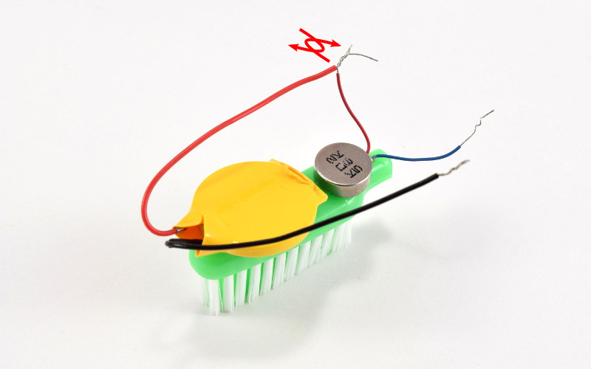
Twist together metal parts of red wires

Slide 8
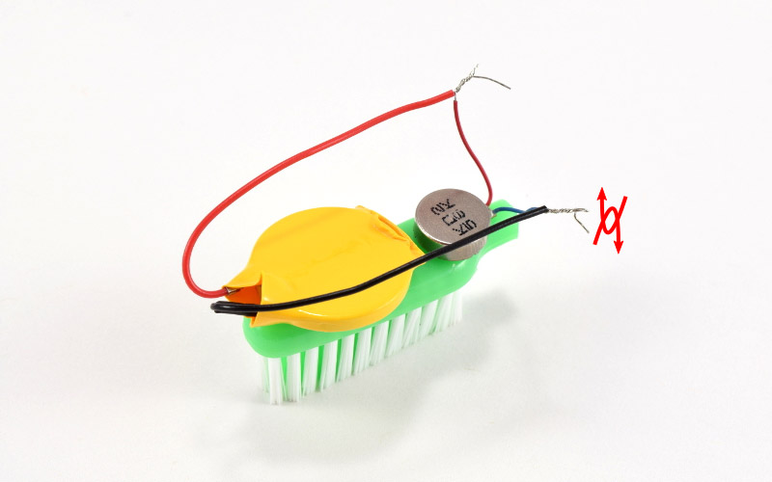
Twist together metal parts of black and blue wires

Slide 9
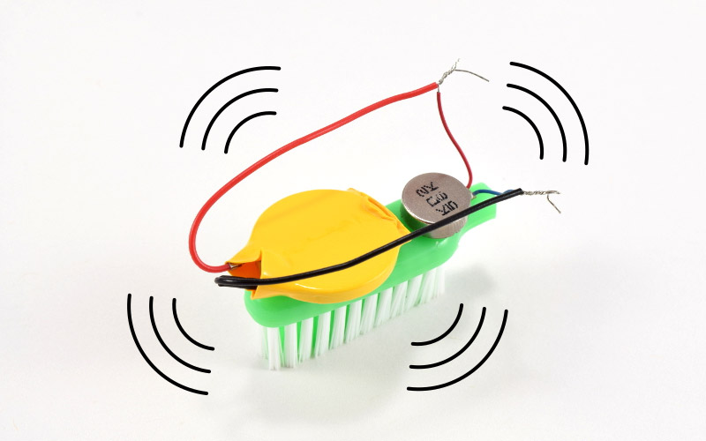
Put your robot down and it should buzz around!

Slide 10
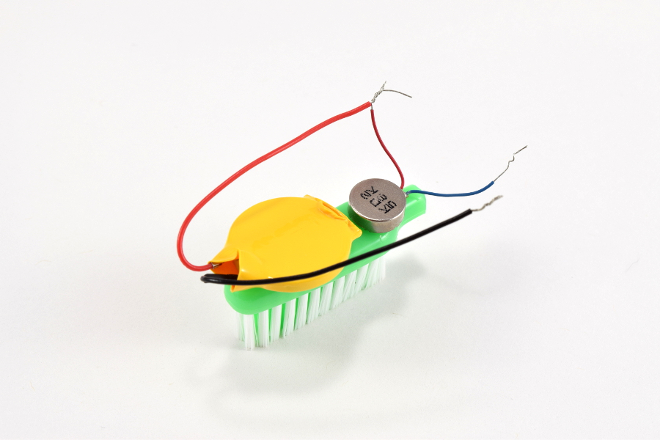
Disconnect one pair of wires to turn your robot off

Slide 11
Troubleshooting

Slide 12
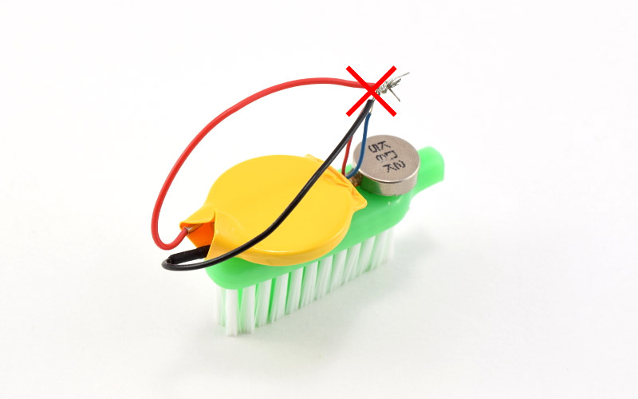
Do not let red and black wires touch

Slide 13
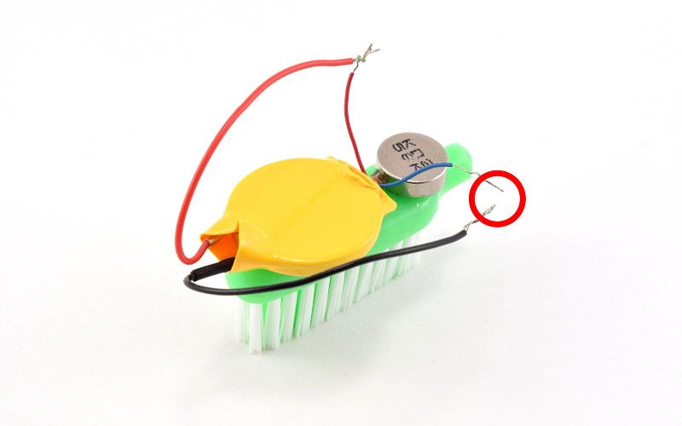
Make sure wires stay twisted together

Slide 14
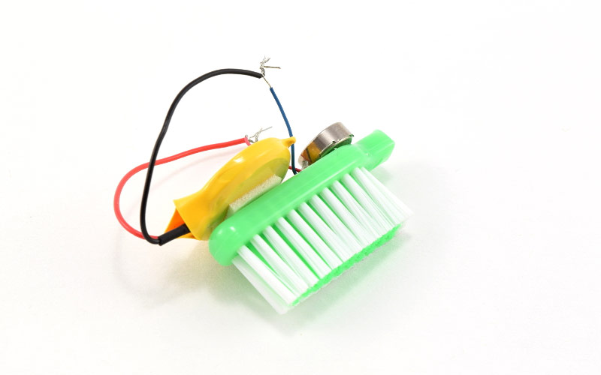
Make sure battery and motor are centered on toothbrush

